Slide 1
How to Code
An improv comedy act
(with brief coding lesson)

Slide 2
An Overview
Language choice
Online resources
Demo some code (time dependent

Slide 3
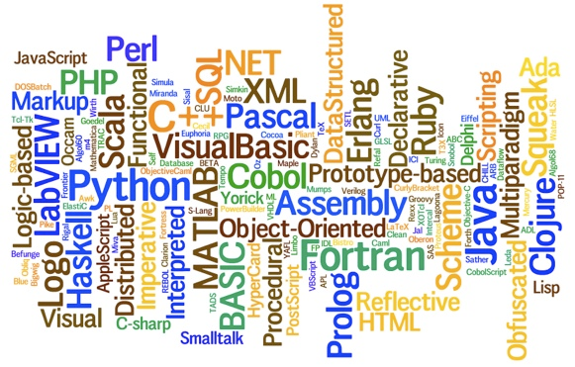
Languages
There are plenty to choose from…
(but don’t worry, none are as bad as English)

Slide 4
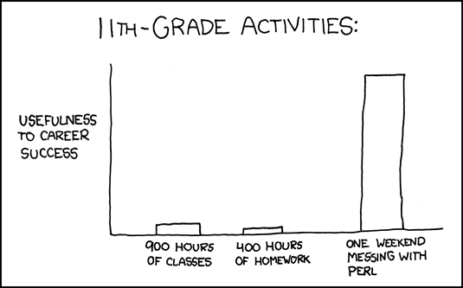
Autodidactism
Self studying FTW

Slide 5
Online Resources
Books are great, but teh interwebz are free!
PAnet =>
Techmasters =>
Web Links =>
Coding Links
Bookmark these pages for later use--even the ones you might find too advanced. They will be useful in the future.

Slide 6
Books Are Still Great
Amazon
Friends
The OWHL
Online (no, we aren’t advocating piracy)
The list we sent out

Slide 7
Apply the Knowledge

